Slide 1
AIC EGERTON CHAPEL
SUNDAY
22.09. 2024

Slide 2
JAMES 2: 1 - 13

Slide 3
INTRODUCTION
September Theme
Phil. 2:3 – Humility
Our Nature Putting on Masks - Hypocrisy

Slide 4
Samuel Johnson
“A true measure of a man is how he TREATS someone who can do him absolutely NO GOOD”

Slide 5
The Real Test of Humility is When Our Faith is PRESSED by FAVOURITISM/PREJUDICE/PARTIALITY/WRONG ATTITUTES

Slide 6
We Suffer and Benefit from FAVOURITISM
Favoritism/Partiality is to give Preference to one person or group – Given position/Something that you don’t deserve – NEPOTISM/TRIBE/DENOMINATION
Hospital –You know the doctor you don’t wait

Slide 7
Our WORLD is filled with Favoritism
Based on; IQ - Smart or Dumb; Color of Skin- Black or White; Hairy or Bald; Good looking or Ugly; Good smell or Bad Smell; Poor or Rich; Tall or Short; Voice- Sounded when we talked; LOOKS

Slide 8
BEAUTY INDUSTRY - has its Special privileges
Studies reliably show that the most physically attractive among us tend to get more attention from parents, better grades in school, more money at work, and more satisfaction from life.
A study published in the Journal of Economics and Business found that good-looking banking CEOs take in over $1 million more in total compensation, on average, than their lesser-looking peers. “Good looks pay off,”

Slide 9
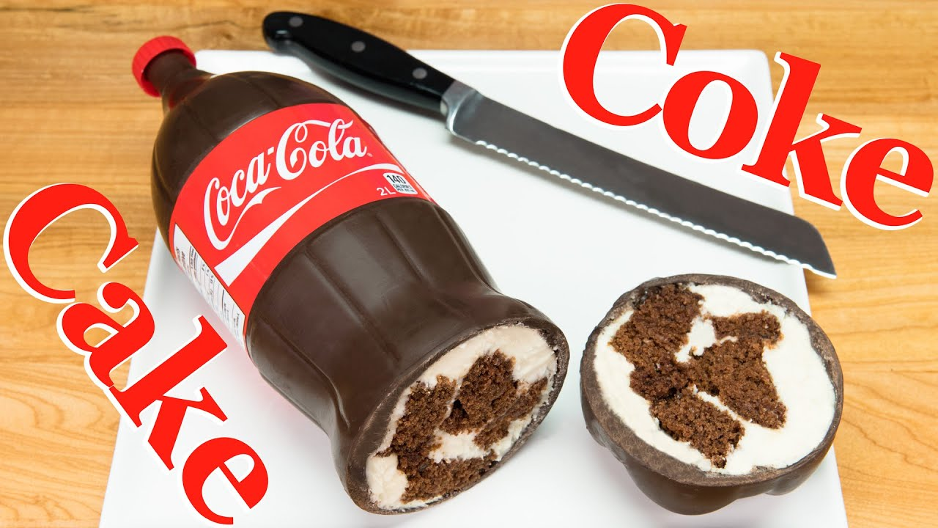
Looks can be Deceptive: Soda Bottle Cake

Slide 10
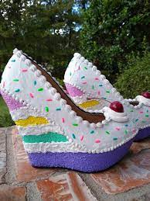

Slide 11
Tweet on this Image of Shoe Cake
“The Year is 2030. Bakery cake is so realistic. Literally anything could be cake. The uncertainty has gripped the World in fear. I go to hug my wife for comfort. She is cake’’

Slide 12
Cont’d
Sometimes it is difficult to know what is beneath the surface

Slide 13
James 2:1-13
James Reminds us that there are TIMES when our Faith is PRESSED by FAVOURITISM or DISCRIMINATION or PARTIALITY or PREJUDICE or CHAUVINISM Based on the Outside LOOKS

Slide 14
James 2:1-13 - Layout
INTRODUCES the Principle – V. 1
ILLUSTRATES the Principle Vv. 2 – 4
EXPLAINS the Principle Vv. 5 – 11
APPLIES the Principle Vv. 12 - 13

Slide 15
James Teaches us that
Faith in Christ and Favoritism or Partiality are INCOMPARTIBLE

Slide 16
Favoritism or Partiality
prosōpolēpsia -comes from two other words: prosopon {“face”) and lambanō (“take, receive”)
A person who shows Favoritism or Partiality decides to treat/respect a person by looking at his or her face

Slide 17
To give judgment or respect based on the outward circumstances of man and not to their intrinsic merits.
Prefers as more worthy, the rich, or powerful, to another who does not have these qualities

Slide 18
James 2:1
“My brothers, as believers/do not hold your faith in our glorious Lord Jesus Christ with an attitude of personal favoritism”
(Rom.2:11;Ephes.6:9; Gal. 2:6).

Slide 19
Cont’d
How can you claim to have Genuine Faith in our Glorious Savior Jesus Christ and Continue Showing Favoritism? Based on Face or Appearance?

Slide 20
Illustration Vv. 2-4
Two People to – Church/Synagogue
1. Dripping with Wealth – Best seat
2. Dripping with Poverty – sit in the corner

Slide 21
Cont’d
They make distinctions based on wealth, ignoring the more important realities of faith and character.

Slide 22
James Gave 3 Reasons WHY this behavior should STOP
1. It is INCONSISTENT with God’s METHOD
V. 5

Slide 23
GOD IS IMPARTIAL
When it comes to JUDGMENT - Rom. 2:11
In HOLDING US ACCOUNTABLE for the way we treat others - Ephes. 6:9
Jesus was impartial in SPEAKING THE TRUTH to all.
Best of all, in OFFERING SALVATION TO ALL. James 2:5

Slide 24
2. It Denies the Universality of Sin V. 6
The rich find it difficult to identify with the Lord Jesus who came as a humble servant
God views all people as equal, if he favors anyone, it is the poor and the powerless. We should follow His example

Slide 25
3. It is INCONSISTENT with Scripture (Vv. 8 -11)
The Royal Law – Lev.19:18
Christ reinforced in Matt. 22:37-40
Paul in Romans 13:8

Slide 26
Let Mercy be our Message V. 12
We deserved DEATH but God by His Grace and Mercy - Forgave
We must all stand before Christ to be Judged – 2 Cor. 5:10

Slide 27
Conclusion
As believers we should not or STOP showing Favoritism Because
It is INCONSISTENT with God’s METHOD- V. 5 - Let love be your Law
It DENIES the UNIVERSALITY OF SIN V. 6 - ------Let Mercy be your Message
It is INCONSISTENT with Scripture (Vv. 8 -11) – ---Let Scripture be your Standard

